Slide 1

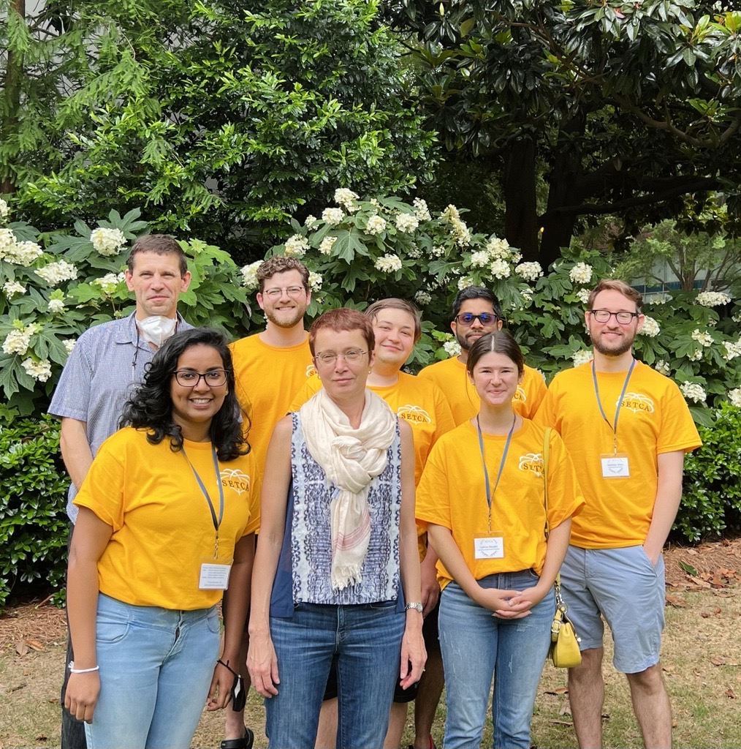




02/15/2023 VISTA
Factorized electron-nuclear dynamics with an effective complex potential
S. Garashchuk, J. Stetzler, V. Rassolov
Dept of Chemistry & Biochemistry
University of South Carolina, Columbia, USA

Slide 2
Outline
1. Motivation and background
2. Nuclear subspace-factorized wavefunctions
3. Vibrationally non-adiabatic model
4. Summary

Slide 3
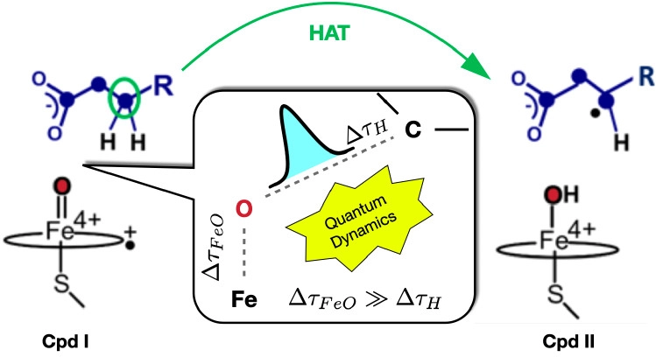
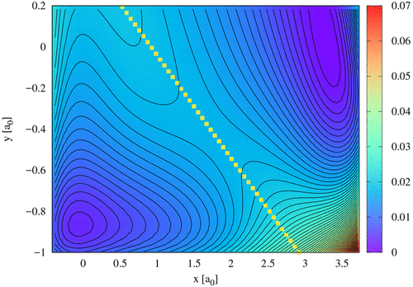
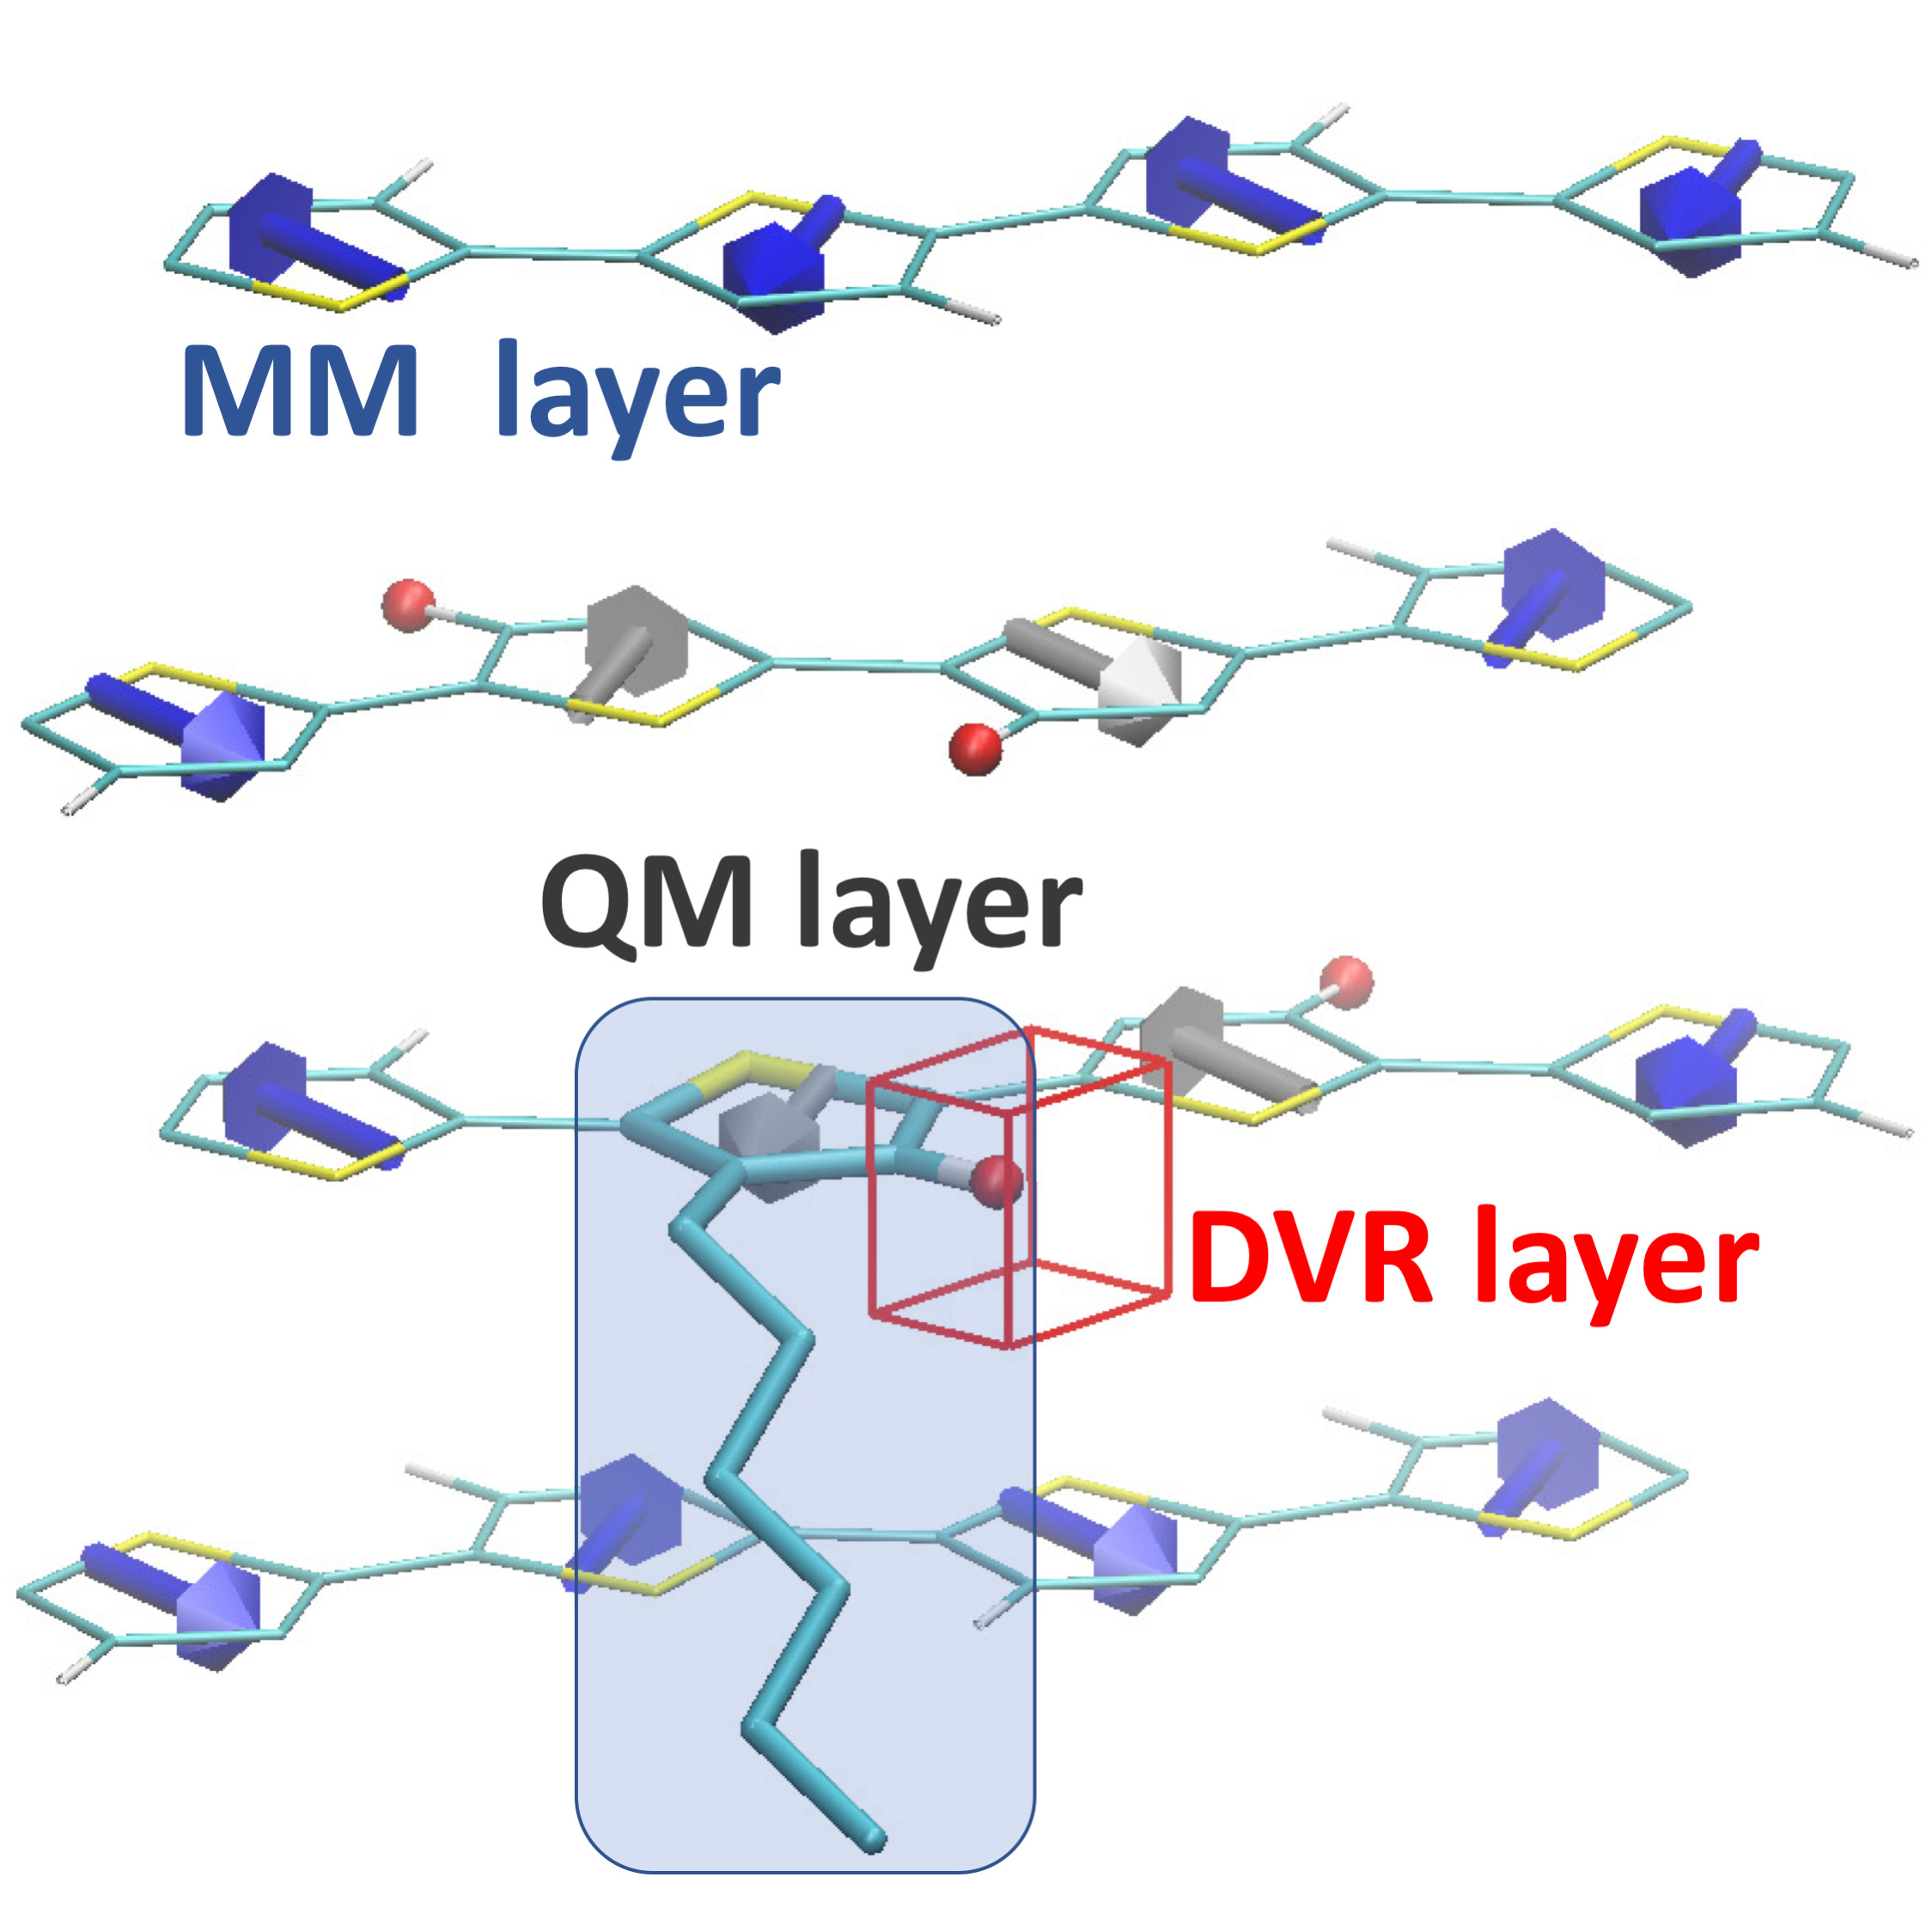
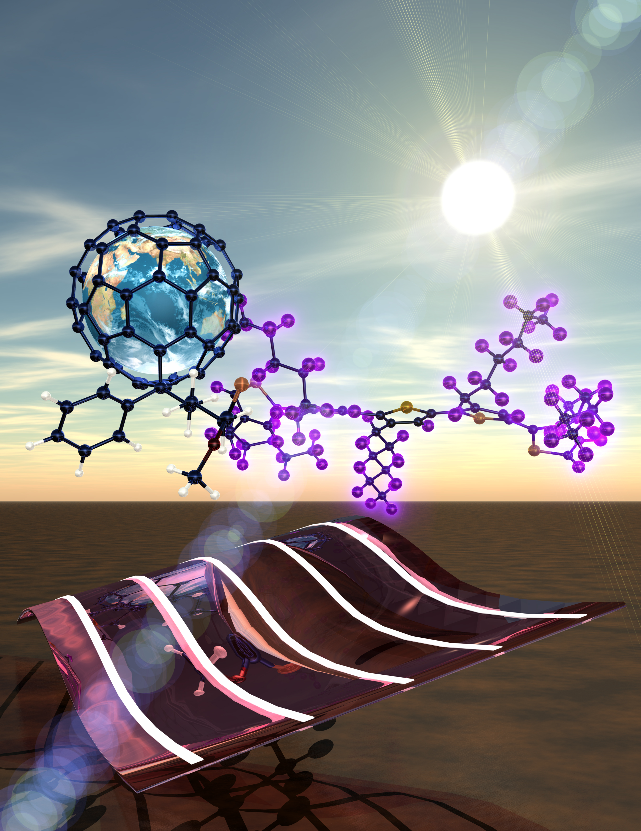
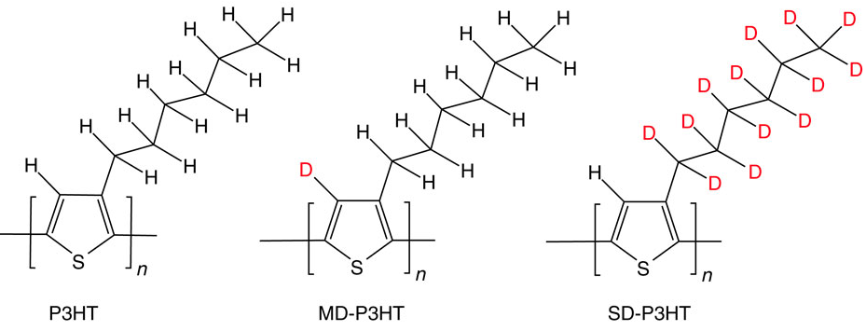
Nuclear quantum effects (NQE)
hard NQE: tunneling
Kinetic Isotope Effect in Cytochrome P450 Decarboxylase OleT
Experiments at T=[4,21]C at transient step: KIE ∼8–16; E_{a}=16/32 kJ/mol
[moderate tunneling; tunneling-ready state]
F=-O Fe-O
Dutra, Amaya, McElhenney, OManley, Makris, Rassolov, SG J. Phys. Chem. B 126 (2022); J. Phys. Chem. A 126 (2022)
H/D substitution reduces polymer crystallinity of P3HT when D on main chain, but not on side chain
[ΔΔZPE crystal vs chain & NQE on dipoles, interchain correlation]
soft NQE: ZPE, anharmonicity
Jakowski, Huang, SG, Hong, Keum, Bobby Sumpter JPCL 2017
electronic excitations + NQE
V_{oc}: 0.58 0.57 0.34 V
H/D isotope effect on the optoelectronic properties of P3HT/PCBM
[fluctuations in HOMO-LUMO gaps]
https://www.ornl.gov/news/solar-surprise
Nature Comm. 5, 4180 (2013) doi:10.1038/ncomms4180
JCTC 12 (2016) Wang, Jakowski, SG, Sumpter
Notes:
Isotope-dependent fluctuations (.16 vs 0.03 eV) of HOMO-LUMO gaps (1.6 eV)
of P3HT, poly-(3-hexylthiophene)

Slide 4
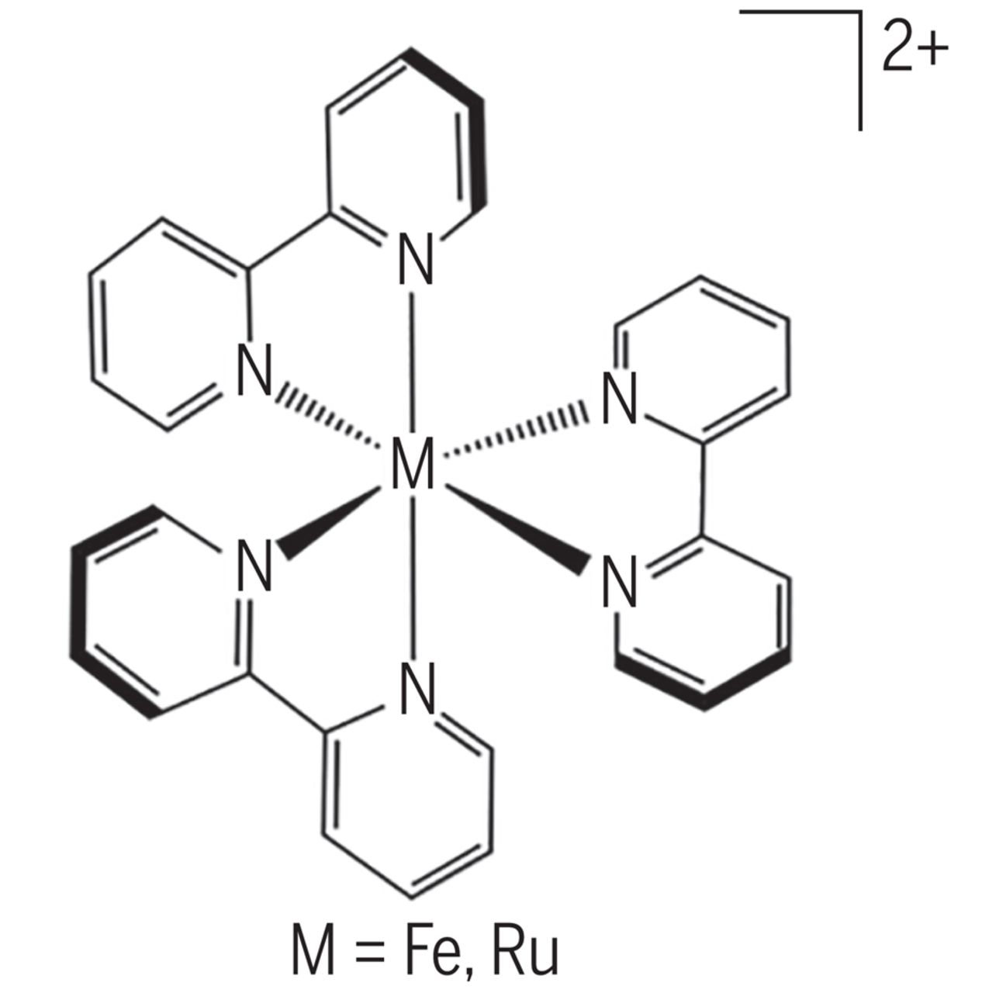
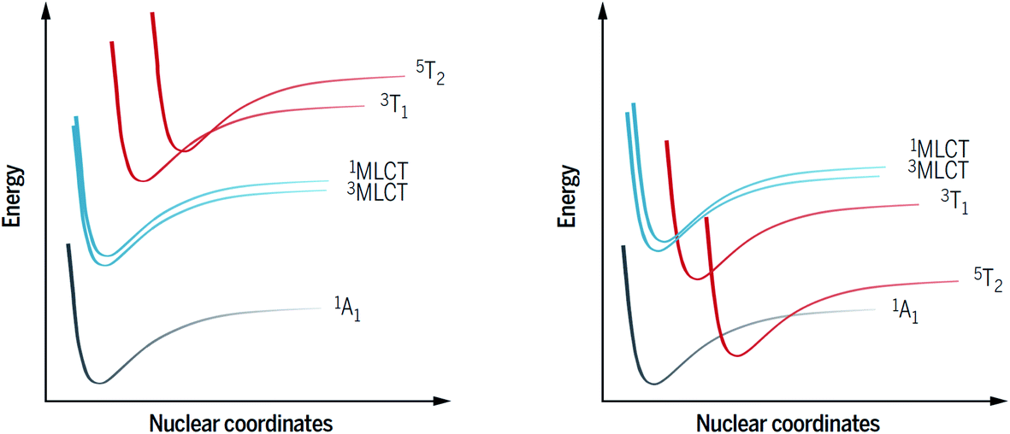
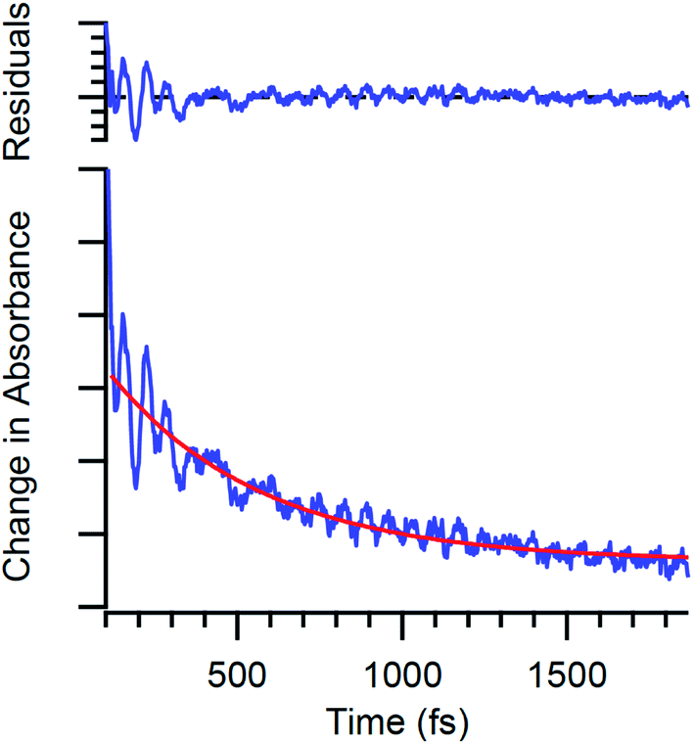
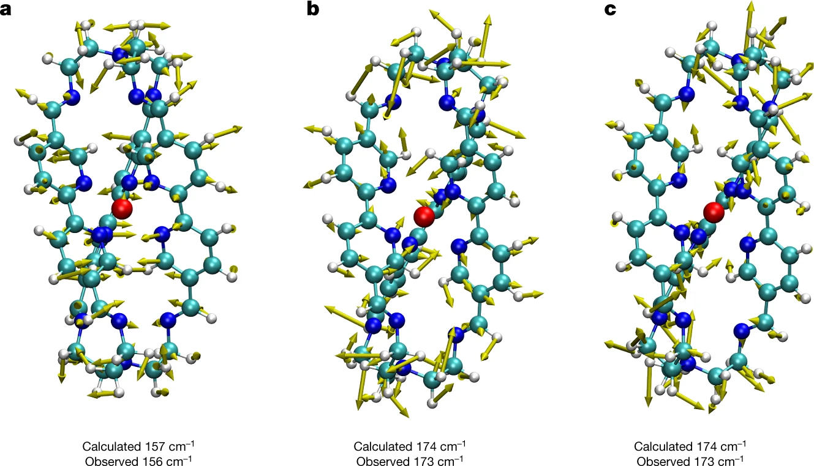
Bryan C. Paulus ª and James K. McCusker *ª
coherence@photocatalysis
Using coherence to enhance function in chemical and biophysical systems
Scholes, G., Fleming, G., Chen, L. et al.. Nature 543, 647–656 (2017).
On the use of vibronic coherence to identify reaction coordinates for ultrafast excited-state dynamics of transition metal-based chromophores
Paulus, McCusker Faraday Discussions 237, 274 (2022).
high yield
long-lived electronic excitations
earth-abundant metals in chromopohores
reversibility, favorable redox energetics
property and functionality control
Leveraging excited-state coherence for synthetic control of ultrafast dynamics
Paulus, B.C., Adelman, S.L., Jamula, L. et al. Nature 582, 214–218 (2020).
Ru ~100 ns
Fe ~ 100 fs
Photoinduced electron transfer
MLCT: metal-to-ligand charge transfer
X
identify DOFs coupled to MLCT→T evolution
chemical perturbation: 100-fold increase of MLCT lifetime
Notes:
DOE-sponsored workshop: coherent electronic motion, such as charge migration and quantum interference between electrons. Attosecond lasers may enable studies of electron-nuclear wavepacket motion; reactivity of metal centres might be directed or redox chemistry tuned by interference effects to modify the electron density at an active site of a catalyst
Volume 237, 2022 : Faraday Discussions
On the use of vibronic coherence to identify reaction coordinates for ultrafast excited-state dynamics of transition metal-based chromophores
Bryan C. Paulus ª and James K. McCusker *ª
Qualitative potential energy surface diagrams appropriate for an octahedral d⁶ metal ion of the second or third transition series (left) and the first-row (right). The inversion in relative energies between the MLCT and ligand-field states contributes to ultrafast non-radiative decay in the case of the latter, which limits the utility of compounds like [Fe(bpy)₃]²⁺ for photo-induced electron transfer chemistry. Adapted from ref. 19.

Slide 5
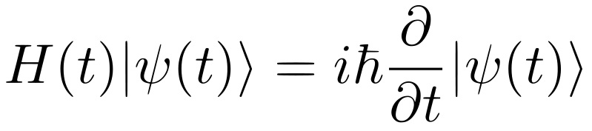
quantum dynamics ~ quantum nuclei
NQEs and time-dependent Hamiltonians + exponential scaling of complexity
take advantage of mass, energy and time-scale separation
time-dependent bases, multilayer representations, trajectories
established approaches for electrons + nuclei
Born-Oppenheimer approx. → PES
Classical trajectories for the nuclei
Multiple electronic PES
Ehrenfest trajectory dynamics; surface hopping
Kinetic (non-adiabatic) vs potential (diabatic) formulation
Derivatives of PES w/r to nuclear positions are zeros
Backreaction from nuclear to electronic DOFs
PESs cross; Berry phase
Not exact, non-unique

Slide 6
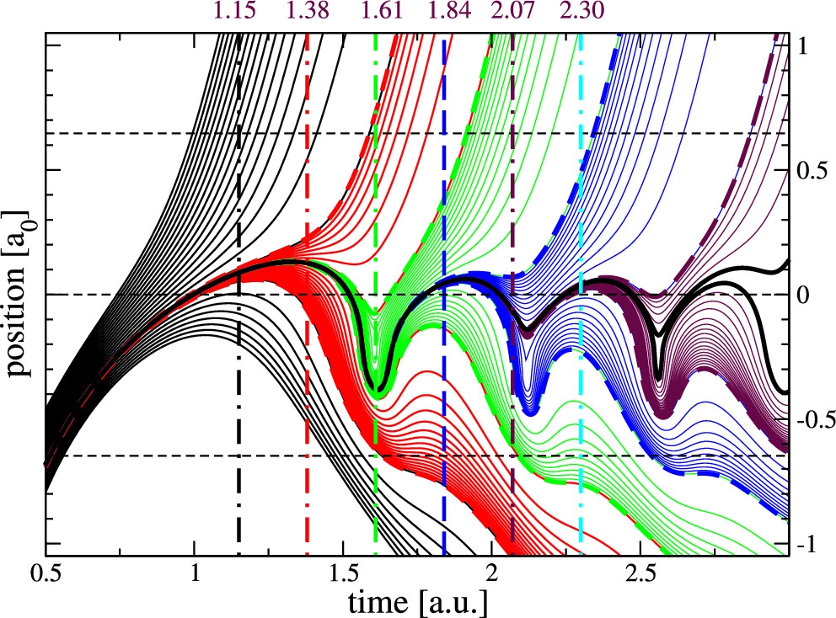
want to include the dominant NQEs within
a trajectory frame for controllable approximations
Tunneling via WF coherence
Exact quantum trajectories (q, p)
barrier
trajectory ‘weight’ conservation
solve for the nuclei and electrons together
Nuclear-electronic orbital (NEO) method
Electron-nuclear dynamics (END); multi-configuration END
Exact factorization (XF), TDPES, conditional WF
Nuclear subspace factorized END with effective complex potential
hard
Deumens and Öhrn “Electron-nuclear dynamics with diabatic and adiabatic wave packets,” J. Phys. Chem. 92, 3181–3189 (1988)
Wang et al Multi-configuration electron–nuclear dynamics: An open-shell approach J. Chem. Phys. 155, 154103 (2021)D
SG, Stetzler, Rassolov “Factorized Electron-Nuclear Dynamics with an Effective Complex Potential” JCTC (2023)

Slide 7
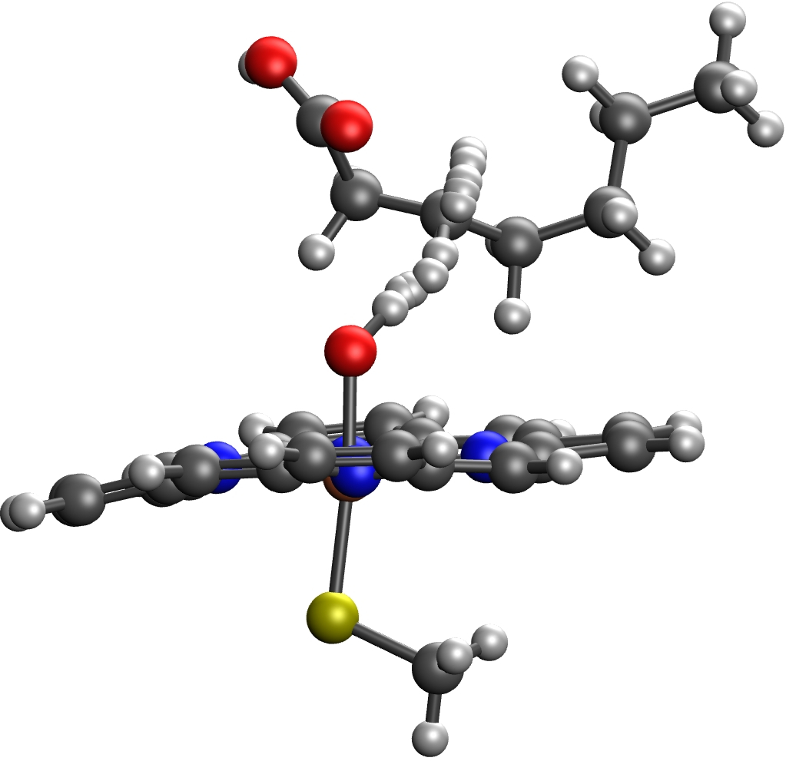
XF- and QT- inspired fast/slow factorization
light: m, x heavy: M, y
requirements
(i) light DOF norm conservation
(ii) continuity eq for heavy DOF along
or trajectory weight conservation
separate TDSEs via a complex potential

Slide 8
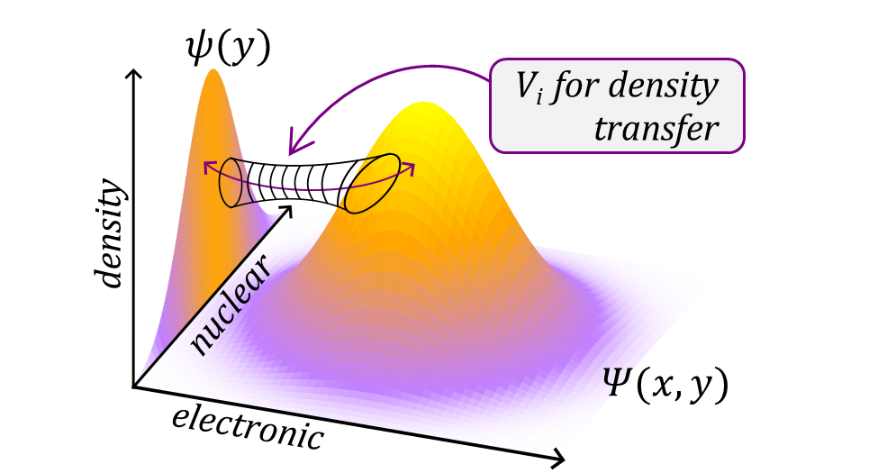
conditions
derivation …
results
trajectory follows the average momentum in y
(normalized by the electronic density at y)
imaginary potential

Slide 9
real potential driving dynamics
try to ‘minimize’ change in S (energy)
S=
does not track y-motion
removes 1st derivative coupling
minimize the nuclear momentum of electronic WF: set to zero
Intermediate ‘electronic’ frame works best (model)

Slide 10
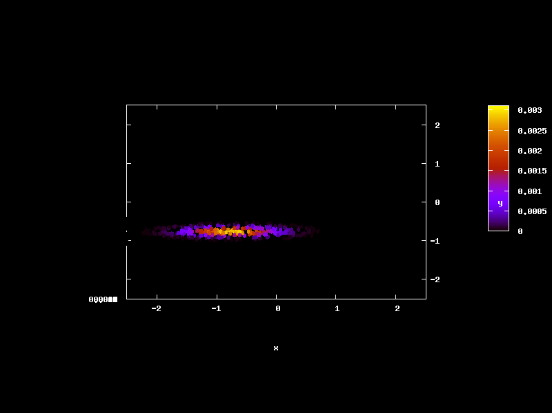
initialize the nuclear WF
so that electronic WF has zero nuclear momentum
- uniform electronic norm
- exact in one nuclear DOF
can be done at all times
ideal or ’exact’
= 0
KST model
two-dimensional Gaussian dynamics

Slide 11
vibrationally nonadiabatic dynamics
IC: complex correlated 2D wavepacket
’electronic’ state populations
nuclear subspace trajectories
V_{r} :=mean-field V_{i} :=0
nuclear WP center
inverse electronic norm

Slide 12
complex effective potential
Lagrangian frame; exact: = ideally factorized; V^{(0,1,2)}:= kinetic energy in V_{r}
nuclear WP center
center momentum
correlates with large imaginary potential ☹
can we have purely real potential?
localization parameter
quadratic phase

Slide 13
‘exact’ corresponds to zero imaginary potential (1 DOF)
condition on V_{r}
frame-independent
p_{φ} , nuclear momentum of electronic function and its dispersion are good measures of efficient factorization
Lagrangian frame
correlates with large imaginary potential ☹
Eulerian frame
intermediate frame

Slide 14
Summary:
QT -- momentum from phase -- define compact WF representations for the ‘BO-and-beyond’ exact, approximate, mixed quantum dynamics
Conservation properties at the expense of complex effective nuclear potential
Imaginary potential is frame-independent; depends on nuclear momentum of electronic wavefunction
Frame of reference affects V_{i} amplitude and dynamics stability
There is (for 1D) an ideally factorized dynamics with zero V_{i} and frame-independent V_{r}
Beyond 1D: intermediate frame, dropping the kinetic energy terms in V_{r} work the best
Future:
The role of the residual nuclear phase in the electronic wavefunction; simplifications
The role of the kinetic energy, including the quantum potential terms
Test systems and chemical models

Slide 15

Thank you VISTA organizers and participants!
Questions?

Slide 16
Propagation scheme for exact implementation
0. initialize nuclear WF
define Vd
update by dt the nuclear SE with complex potential
update by dt the full WF exactly
define the electronic WF at dt as (full WF)/(nuclear WF)
go to 1 and repeat until final time is reached
Gaussian wavepacket

